Slide 1
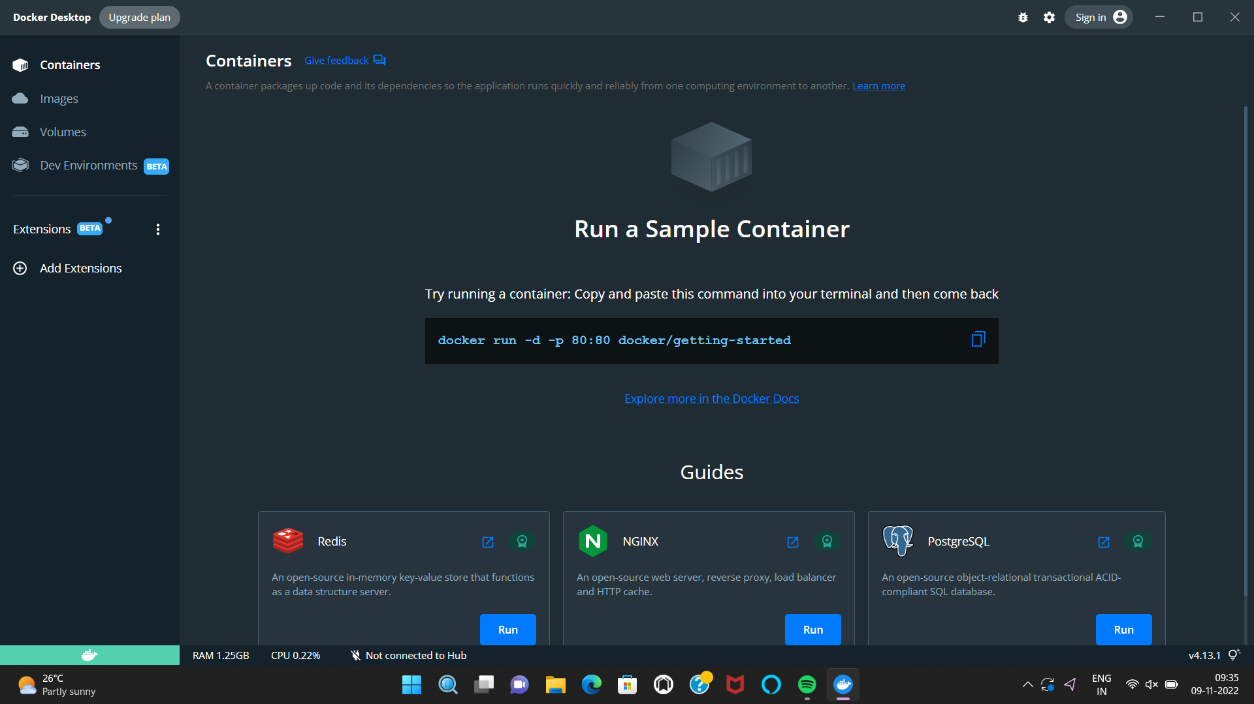
Environment Setup
DOCKER INSTALLATION
Team ID : PNT2022TMID07573

